Slide 1
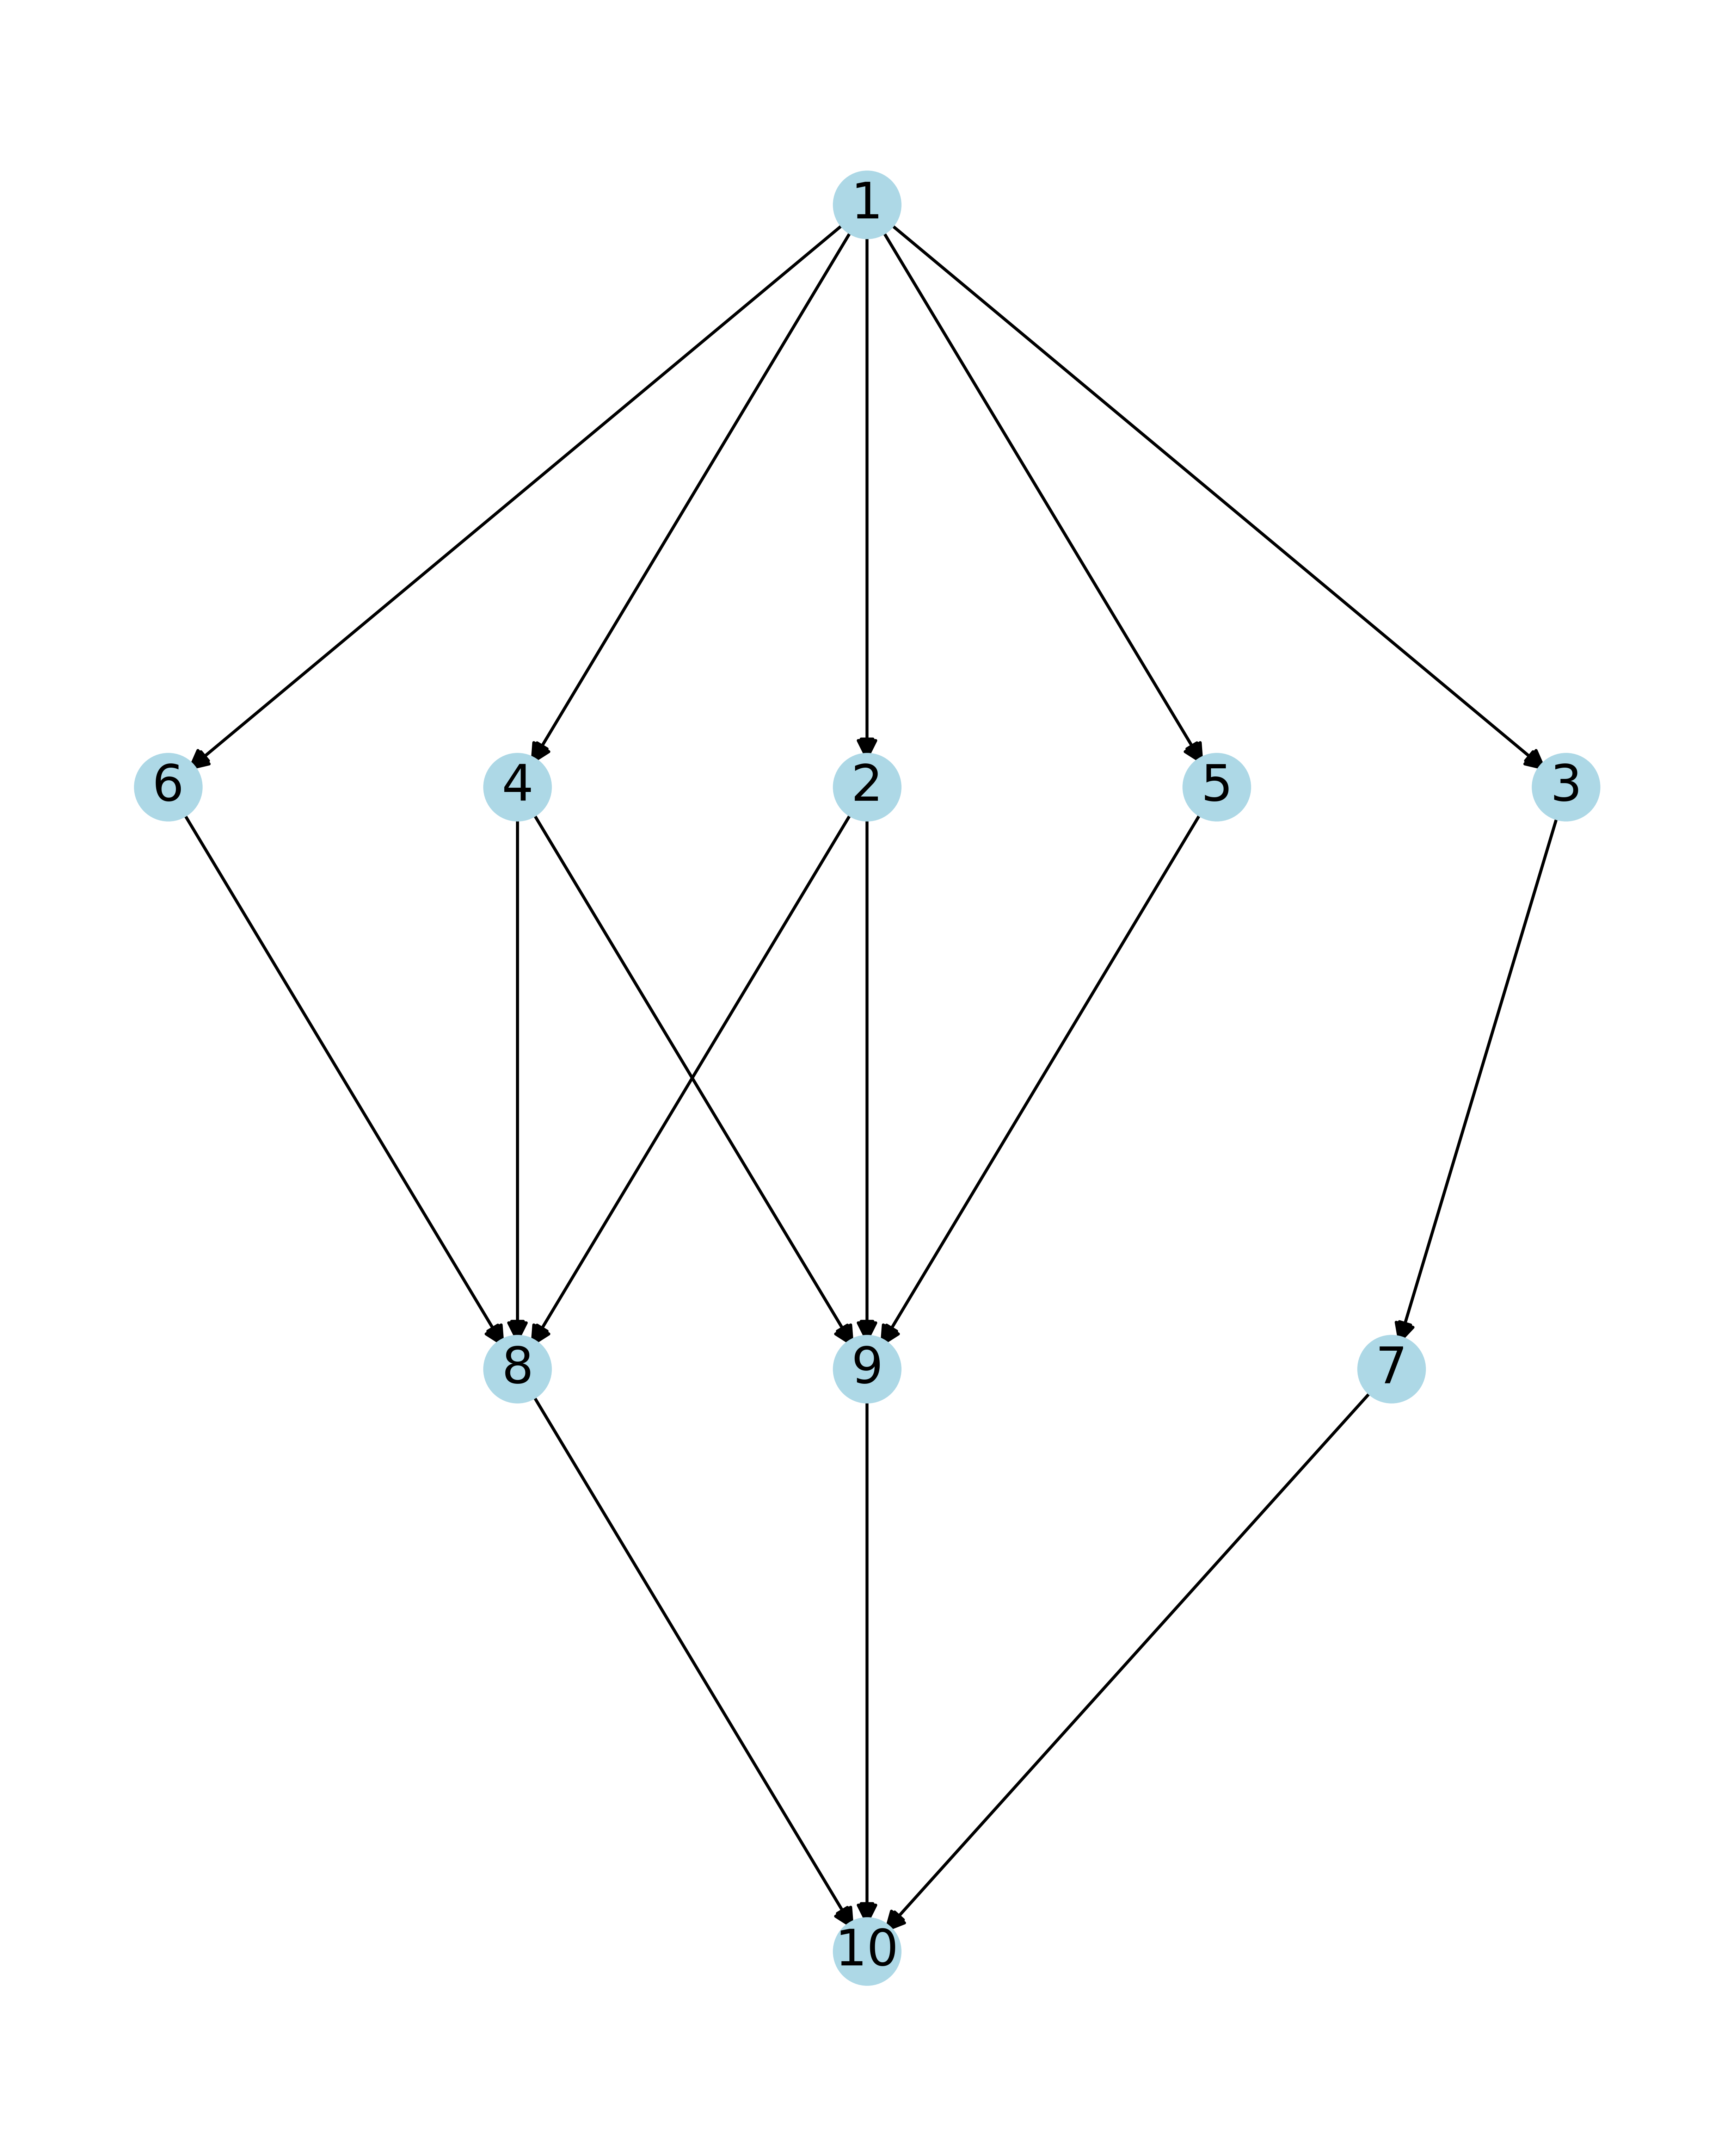
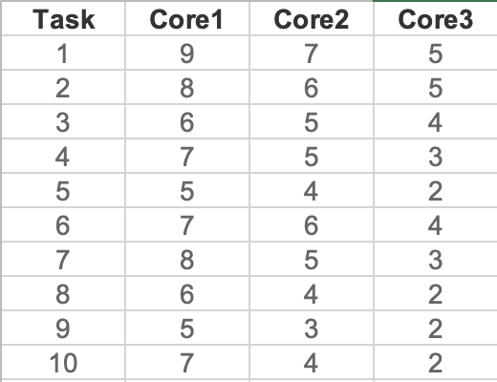
a) Graph 1: Figure 1 of the paper

Slide 2
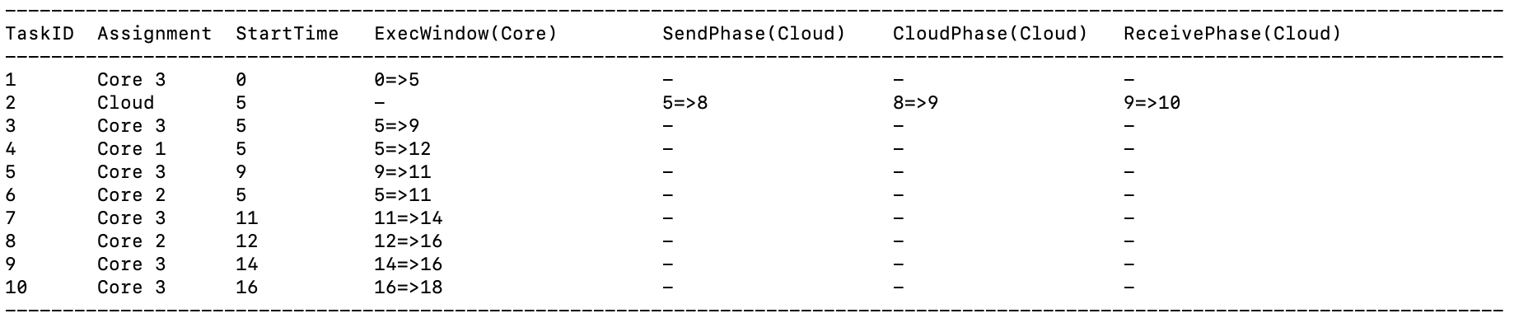
b) Initial Task Schedule Program Output

Slide 3
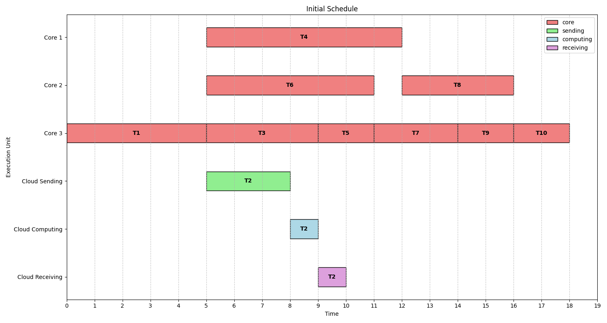
Initial Task Schedule

Slide 4
Total energy consumption of initial scheduling: 100.5
Core1(P1) =1, Core2(P2) = 2, Core3(P2) = 4, Cloud(Ps) =0.5
Core 1 task count = 1(T4)
Core 2 task count = 2 (T6, T8)
Core 3 task count = 6 (T1,T3,T5,T7,T9,T10)
Cloud task Count =1(T2)
E1 = 7 * 1 = 7
E2 = 2 * (6+ 4) = 20
E3 = 4 * (5+4+2+3+2+2) = 72
E_cloud = 0.5 * 3 * 1 = 1.5
E_total of initial scheduling = E1 + E2 + E3 + E_cloud = 7 + 20 + 72 + 1.5 = 100.5

Slide 5
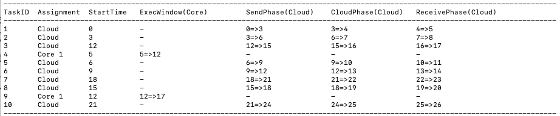
c) Energy Optimized Task Schedule Program Output

Slide 6
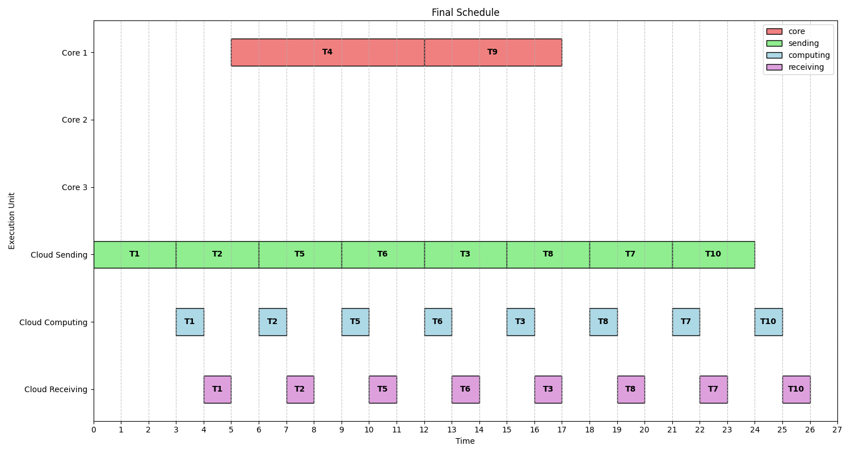
Energy Optimized Task Schedule

Slide 7
Total energy consumption of final scheduling: 24
Core1(P1) =1, Core2(P2) = 2, Core3(P2) = 4, Cloud(Ps) =0.5
Core 1 task count = 2 (T4,T9)
Core 2 task count = 0
Core 3 task count = 0
Cloud task Count = 8 (T1,T2,T3,T5,T6,T7,T8,T10)
E1 = 1 * (7+5) = 12
E2 = 2 * 0 = 0
E3 = 4 * 0 = 0
E_cloud = 0.5 * 3 * 8 = 0.5 * 24 = 12
E_total of final scheduling = E1 + E2 + E3 + E_cloud = 12 + 0 + 0 + 12 = 24

Slide 8
d) Summary
T_total of initial scheduling : 18
E_total of initial scheduling : 100.5
T_total of final scheduling : 26 (< 27 (18*1.5))
E_total of final scheduling : 24

Slide 9
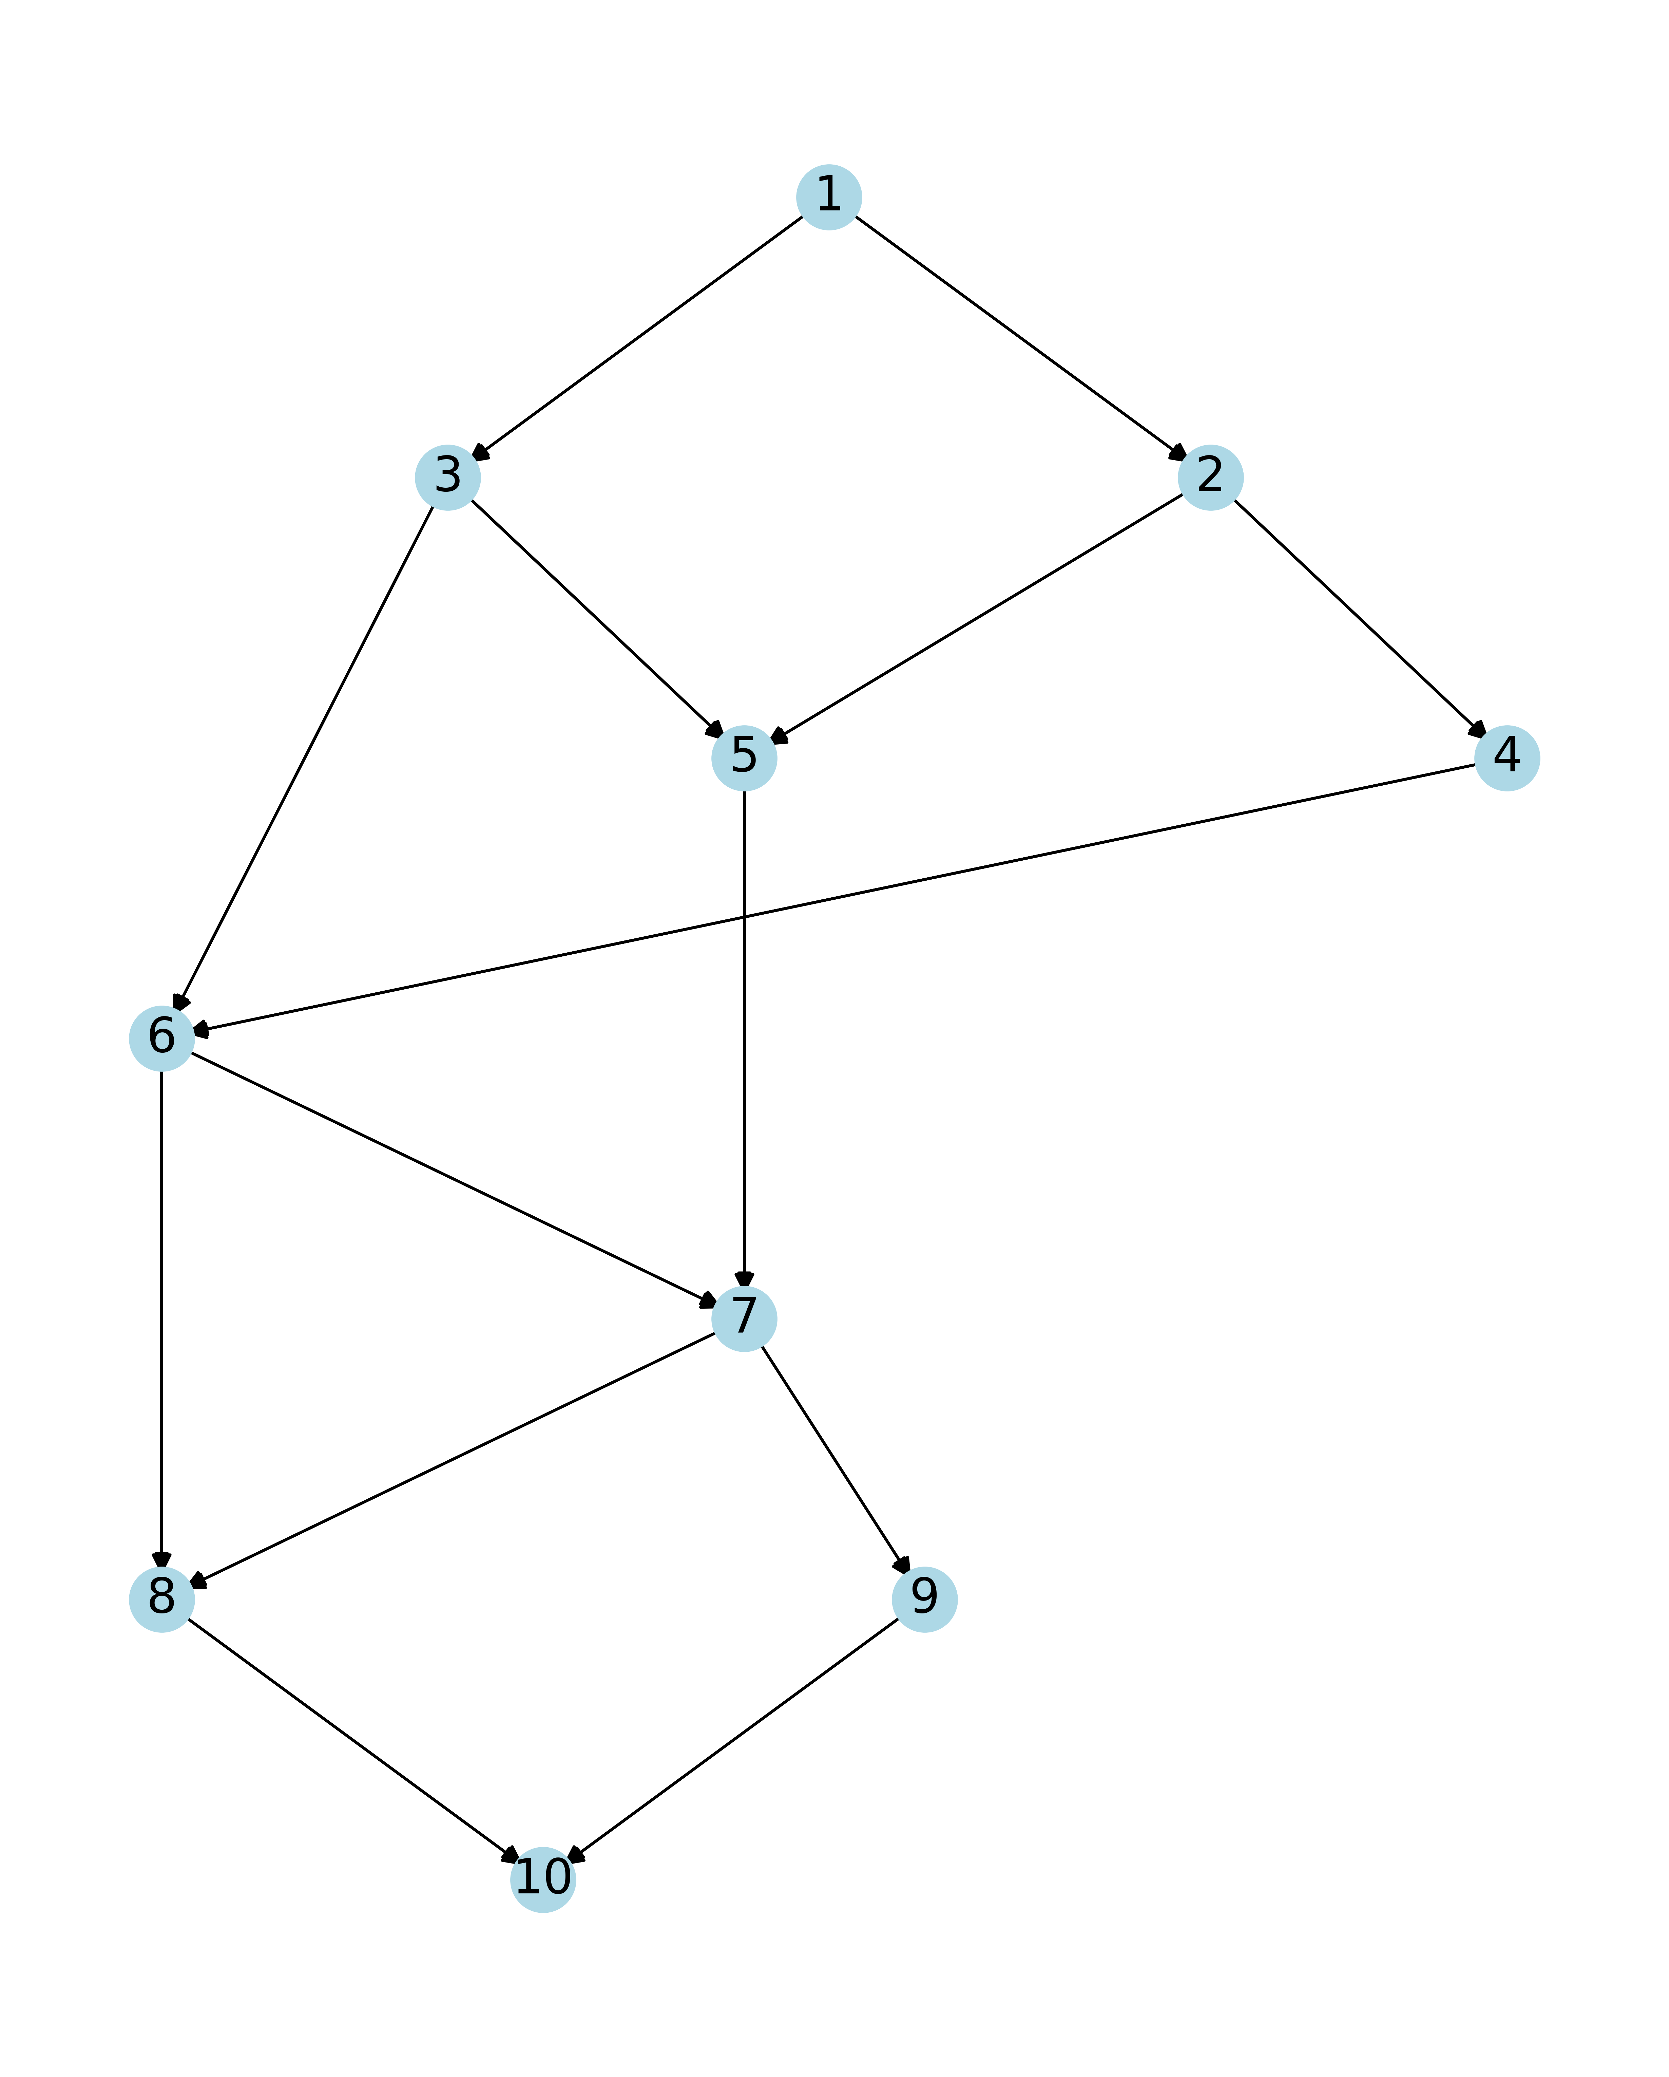
a) Graph 2: Graph1with changed connections

Slide 10
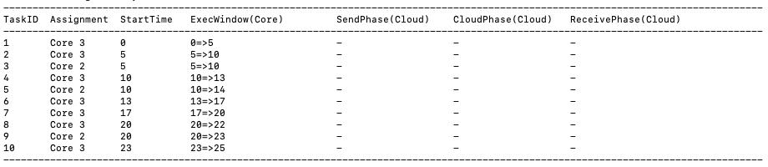
b) Initial Task Schedule Program Output

Slide 11
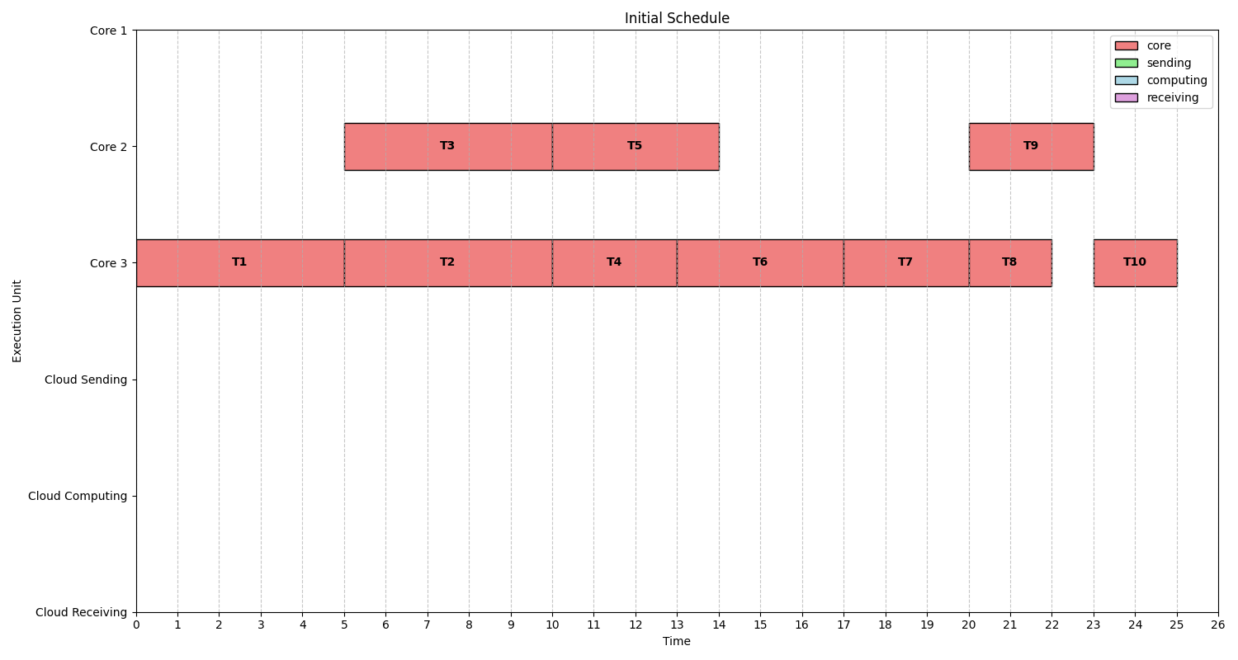
Initial Task Schedule

Slide 12
Total energy consumption of initial scheduling: 120
Core1(P1) =1, Core2(P2) = 2, Core3(P2) = 4, Cloud(Ps) =0.5
Core 1 task count = 0
Core 2 task count = 3 (T3, T5, T9)
Core 3 task count = 7 (T1, T2, T4, T6, T7, T8, T10)
Cloud task Count = 0
E1 = 1 * 0 = 0
E2 = 2 * (5+4+3) = 2 * 12 = 24
E3 = 4 * (5+5+3+4+3+2+2) = 4 * 24 = 96
E_cloud = 0.5 * 0 = 0
E_total of initial scheduling = E1 + E2 + E3 + E_cloud = 0 + 24 + 96 + 0 = 120

Slide 13
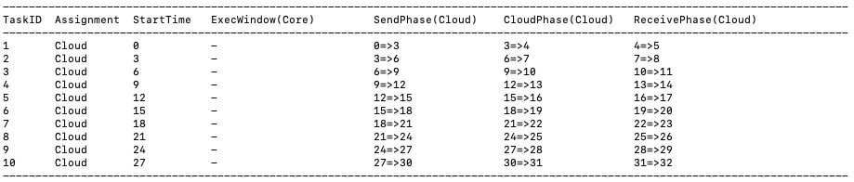
c) Energy Optimized Task Schedule Program Output

Slide 14
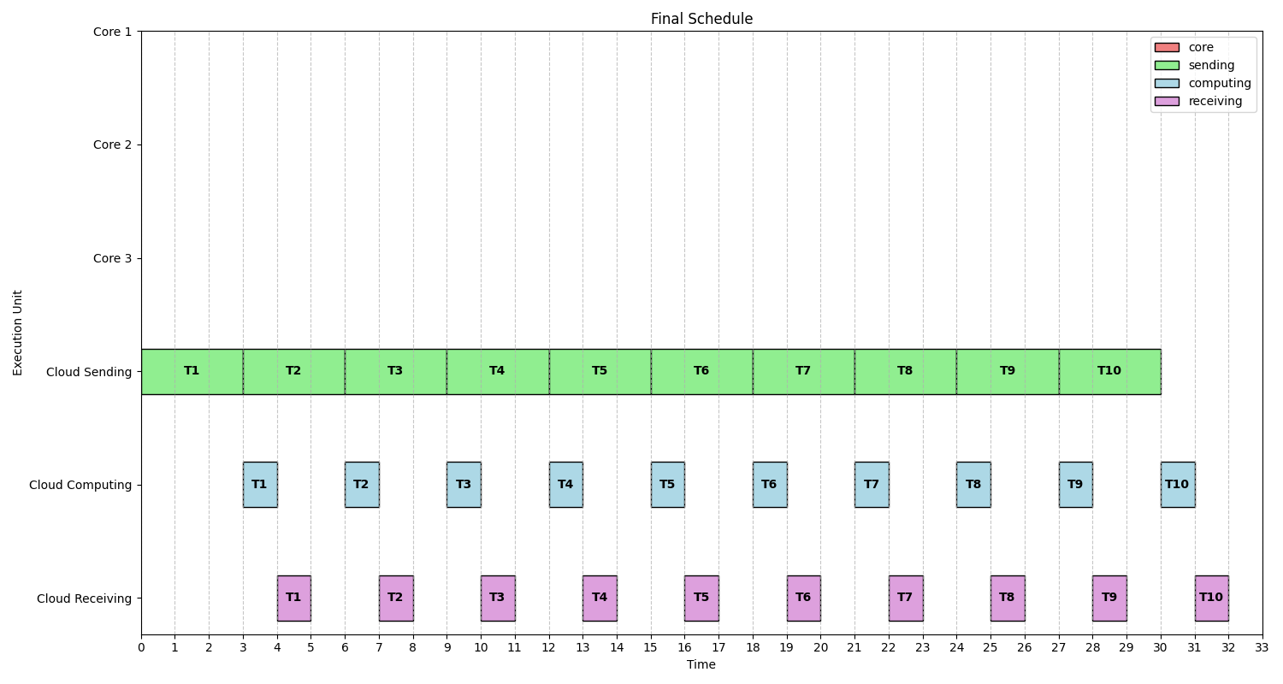
Energy Optimized Task Schedule

Slide 15
Total energy consumption of final scheduling: 15
Core1(P1) =1, Core2(P2) = 2, Core3(P2) = 4, Cloud(Ps) =0.5
Core 1 task count = 0
Core 2 task count = 0
Core 3 task count = 0
Cloud task Count =10 (T1,T2,T3,T4,T5,T6,T7,T8,T9,T10)
E1 = 0
E2 = 0
E3 = 0
E_cloud = 0.5 * 3 * 10 = 15
E_total of initial scheduling = E1 + E2 + E3 + E_cloud = 0 + 0 + 0 + 15 = 15

Slide 16
d) Summary
T_total of initial scheduling : 25
E_total of initial scheduling : 120
T_total of final scheduling : 32 (<37.5 (25*1.5))
E_total of final scheduling : 15

Slide 17
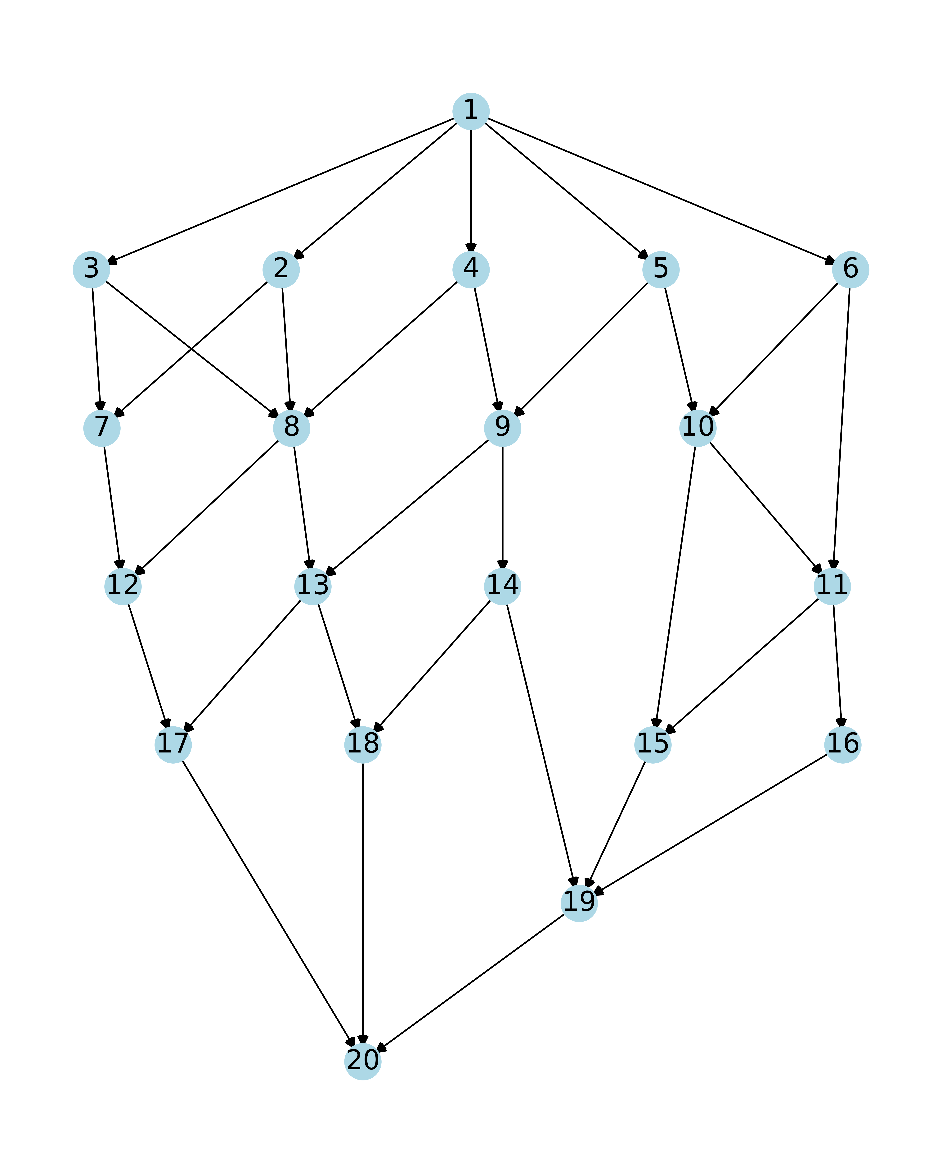
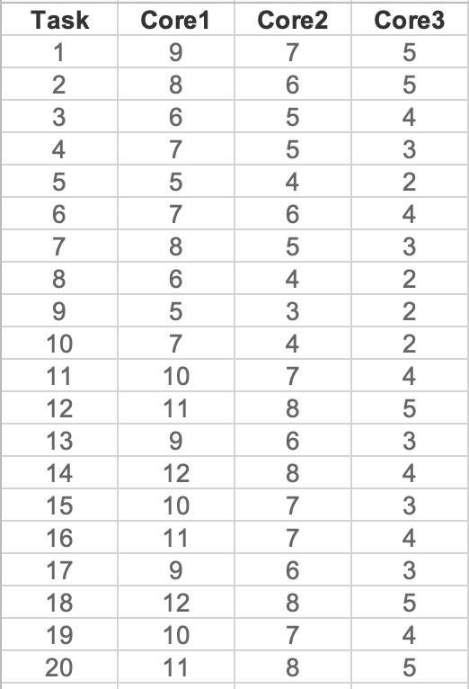
a) Graph 3: Graph with 20 tasks

Slide 18
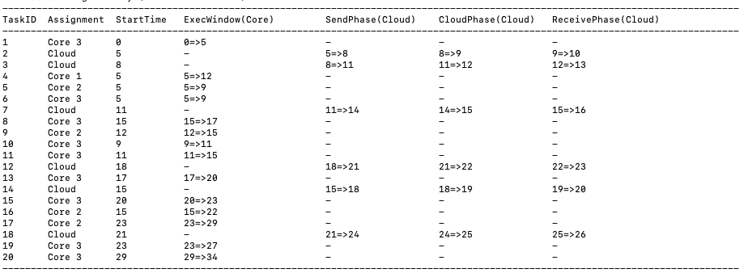
b) Initial Task Schedule Program Output

Slide 19
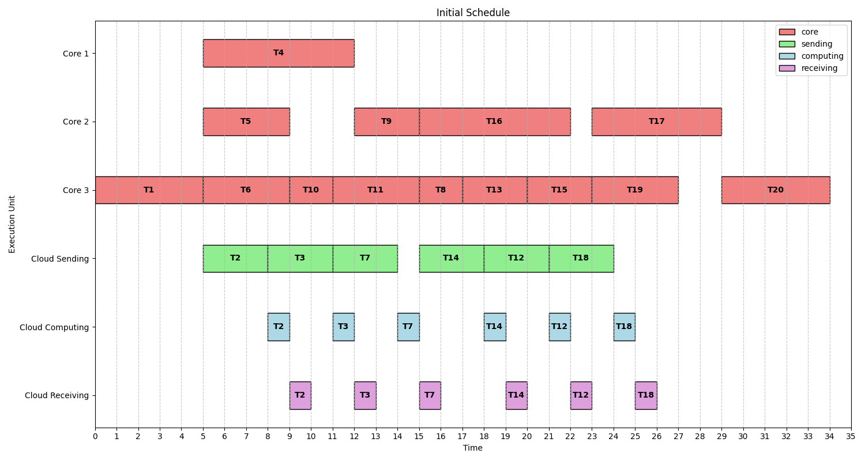
Initial Task Schedule

Slide 20
Total energy consumption of initial scheduling: 184
Core1(P1) =1, Core2(P2) = 2, Core3(P2) = 4, Cloud(Ps) =0.5
Core 1 Task Count: 1 (T4)
Core 2 Task Count: 4 (T5, T9, T16, T17)
Core 3 Task Count: 9 (T1, T6, T10, T11, T8, T13, T15, T19, T20)
Cloud Task Count: 6 (T2, T3, T7, T14, T12, T18)
E1 = P1 * (Core 1 total time) = 1 * 7 = 7
E2 = P2 * (Core 2 total time) = 2 * 20 = 40
E3 = P3 * (Core 3 total time) = 4 * 32 = 128
E_cloud = Ps * (Total sending time) = 0.5 * 3 * 6 = 9
E_total of initial scheduling = E1 + E2 + E3 + E_cloud = 7 + 40 + 128 + 9 = 184

Slide 21
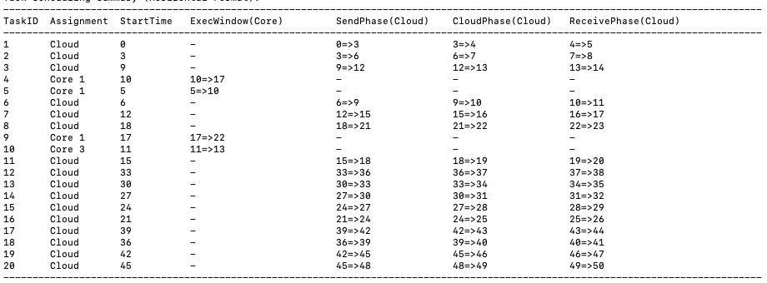
c) Energy Optimized Task Schedule Program Output

Slide 22
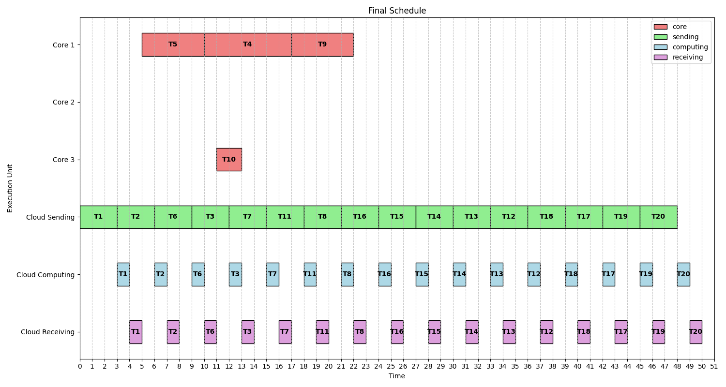
Energy Optimized Task Schedule

Slide 23
Total energy consumption of final scheduling: 49
Core1 (P1) = 1, Core2 (P2) = 2, Core3 (P2) = 4, Cloud (Ps) = 0.5
Core 1 Task Count: 3 (T5, T4, T9)
Core 2 Task Count: None
Core 3 Task Count: 1 (T10)
Cloud Task Count: 16 (T1, T2, T3, T6, T7, T8, T11, T12, T13, T14, T15, T16, T17, T18, T19, T20)
E1 = 1 * 17 = 17
E2 = 2 * 0 = 0
E3 = 4 * 2 = 8
E_cloud = 0.5 * 16 * 3 = 24
E_total of final scheduling = E1 + E2 + E3 + E_cloud = 17 + 0 + 8 + 24 = 49

Slide 24
d) Summary
T_total of initial scheduling : 34
E_total of initial scheduling : 184
T_total of final scheduling : 50 (< 51 (34*1.5))
E_total of final scheduling : 49

Slide 25
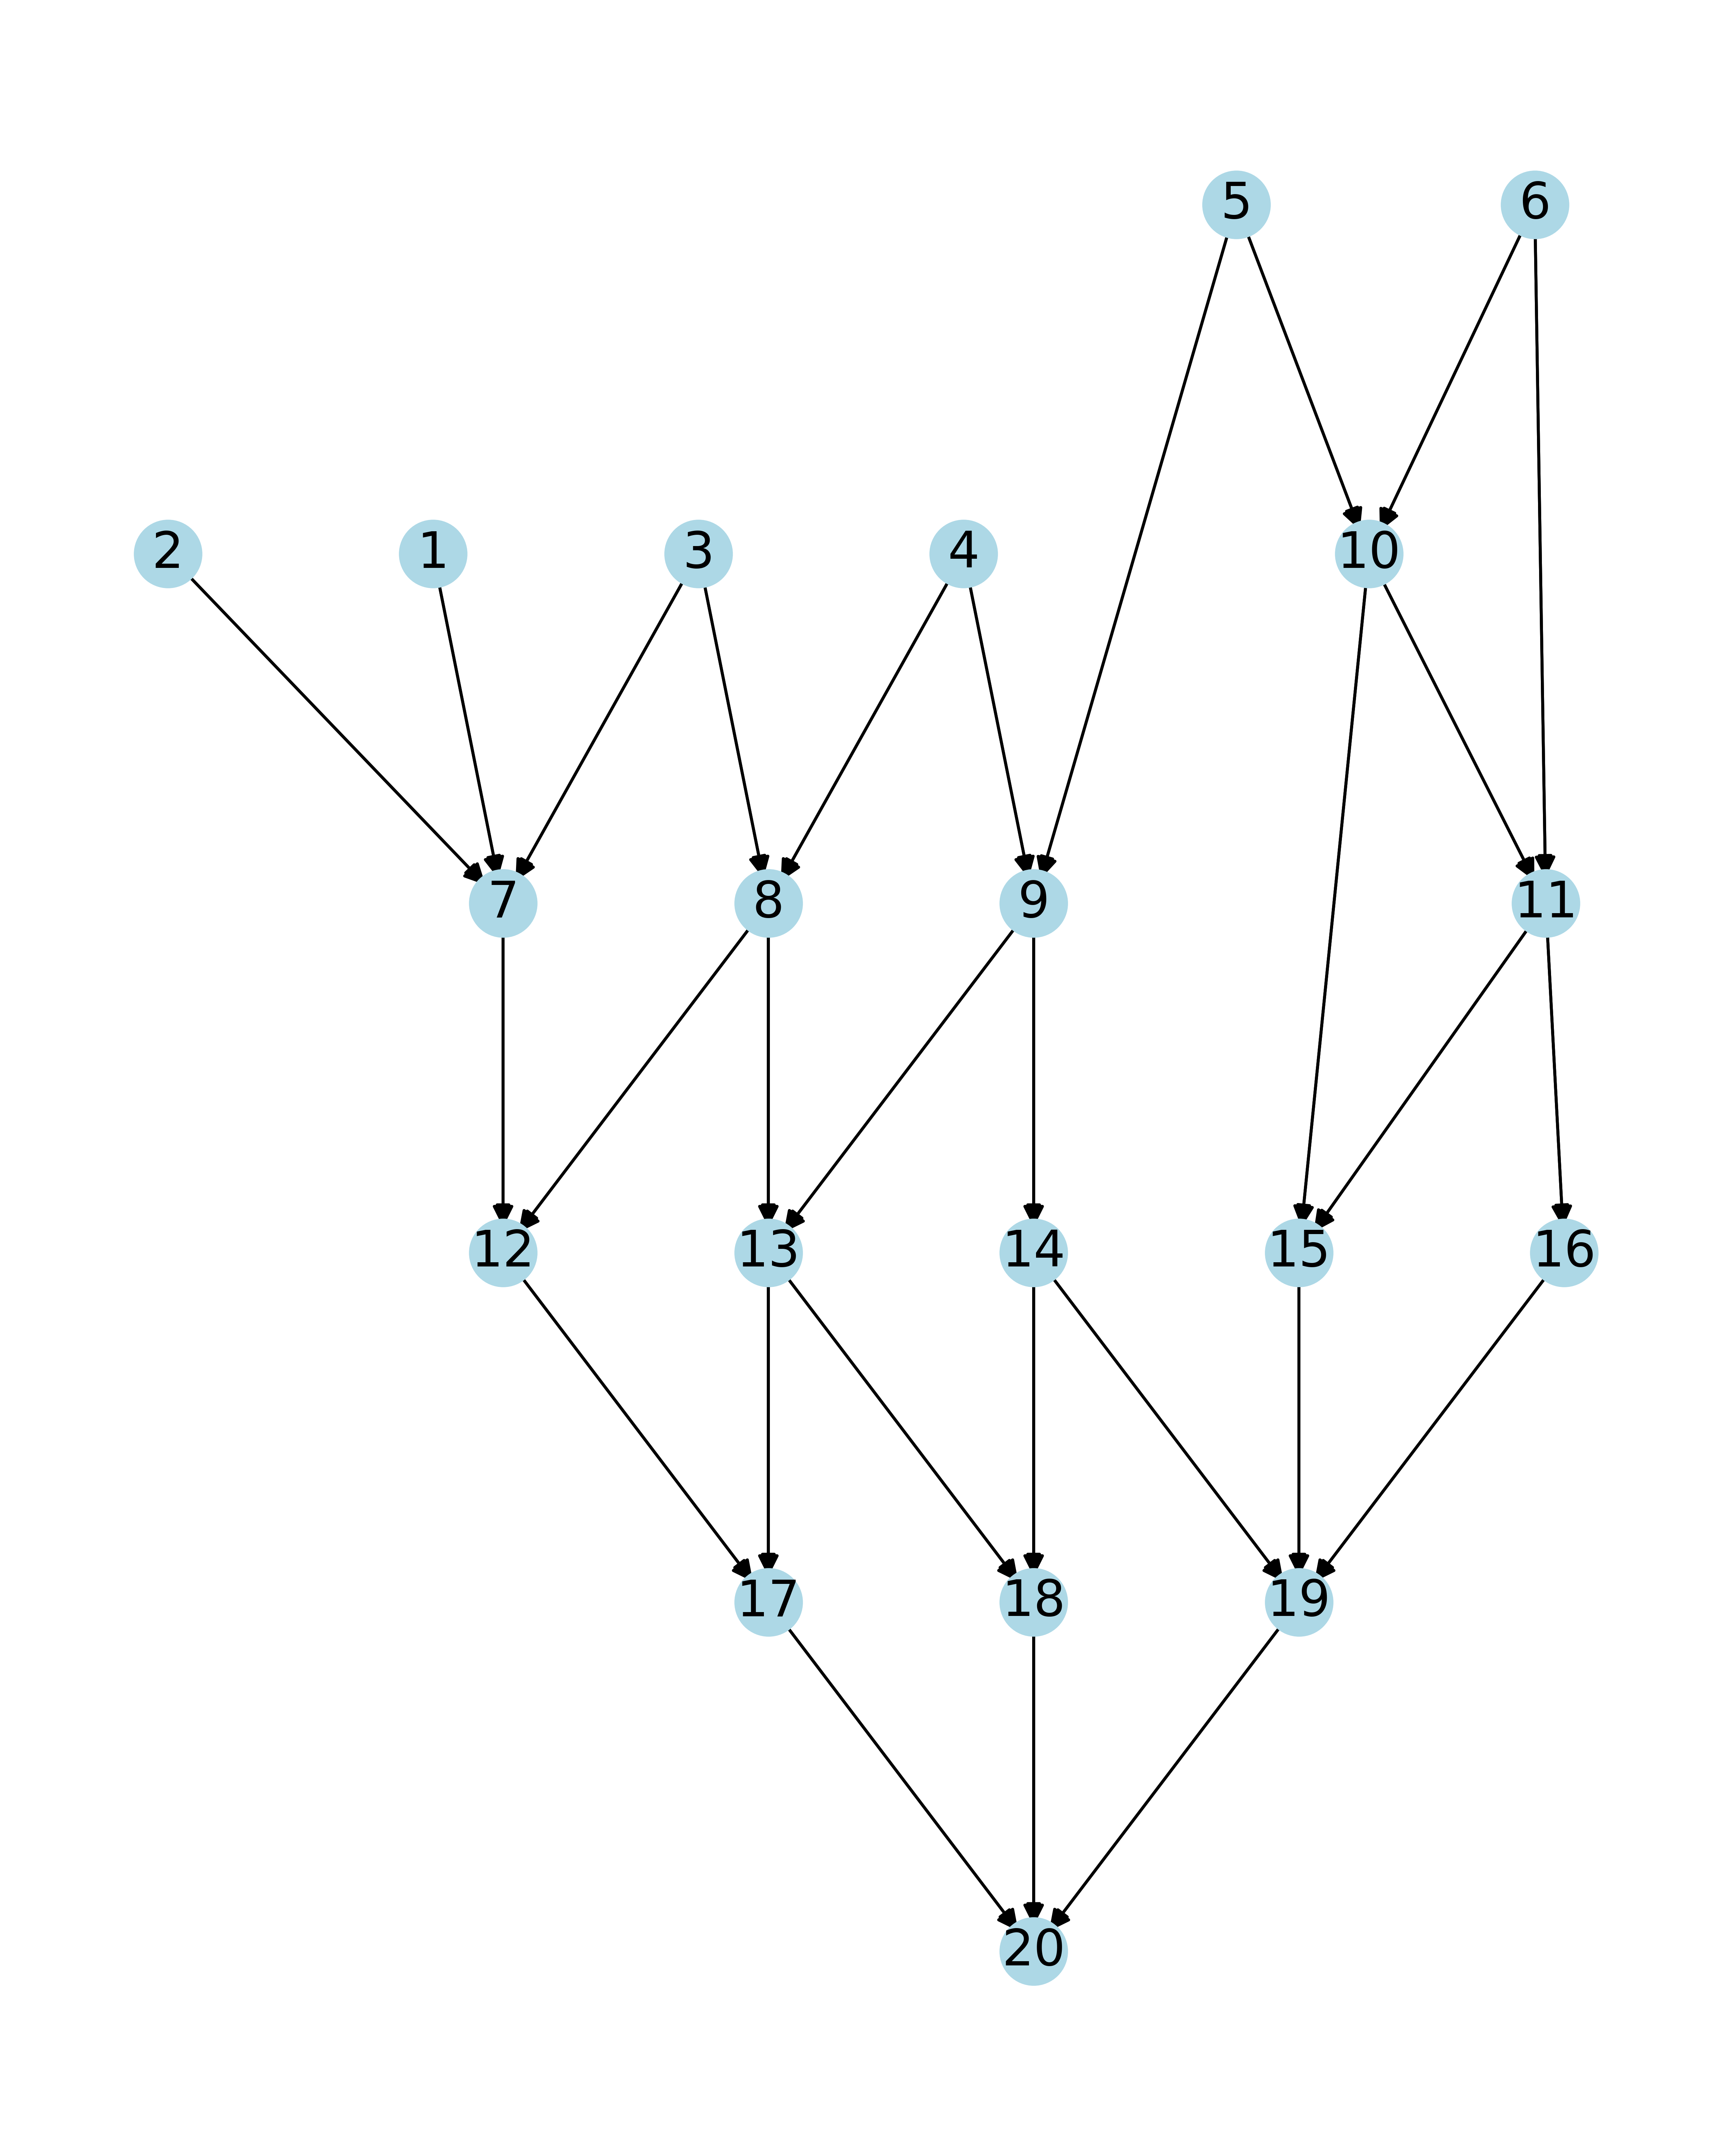
a) Graph 4: Graph3 with multiple entry tasks

Slide 26
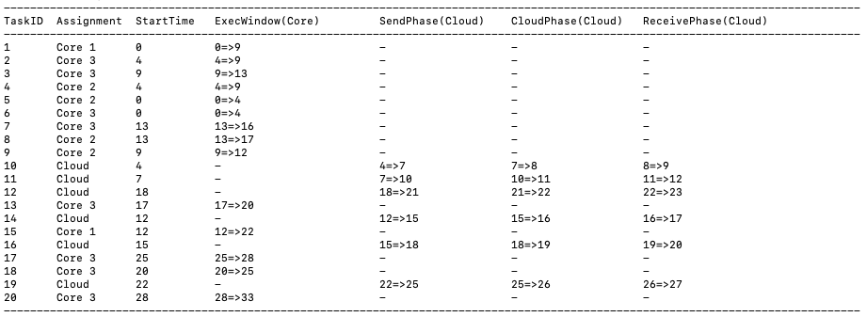
b) Initial Task Schedule Program Output

Slide 27
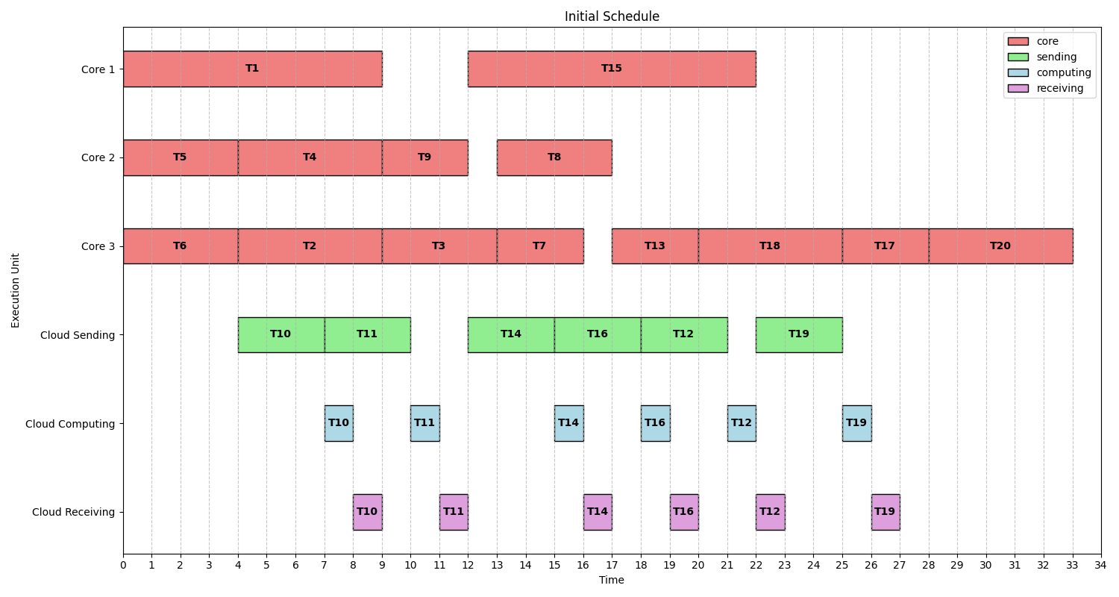
Initial Task Schedule

Slide 28
Total energy consumption of initial scheduling: 188
Core1 (P1) = 1, Core2 (P2) = 2, Core3 (P2) = 4, Cloud (Ps) = 0.5
Core 1 Task Count: 2 (T1, T15)
Core 2 Task Count: 4 (T5, T4, T9, T8)
Core 3 Task Count: 8 (T6, T2, T3, T7, T13, T18, T17, T20)
Cloud Task Count: 6 (T10, T11, T14, T16, T12, T19)
E1 = 1 * 19 = 19
E2 = 2 * 16 = 32
E3 = 4 * 32 = 128
E_cloud = 0.5 * 6 * 3 = 9
E_total of initial scheduling = E1 + E2 + E3 + E_cloud = 19 + 32 + 128 + 9 = 188

Slide 29
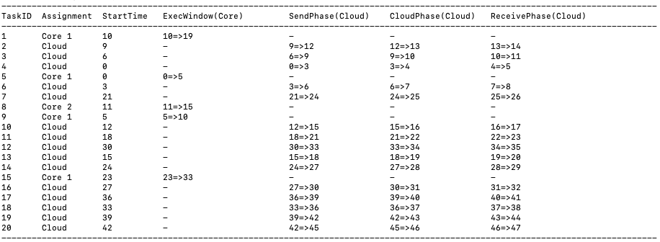
c) Energy Optimized Task Schedule Program Output

Slide 30
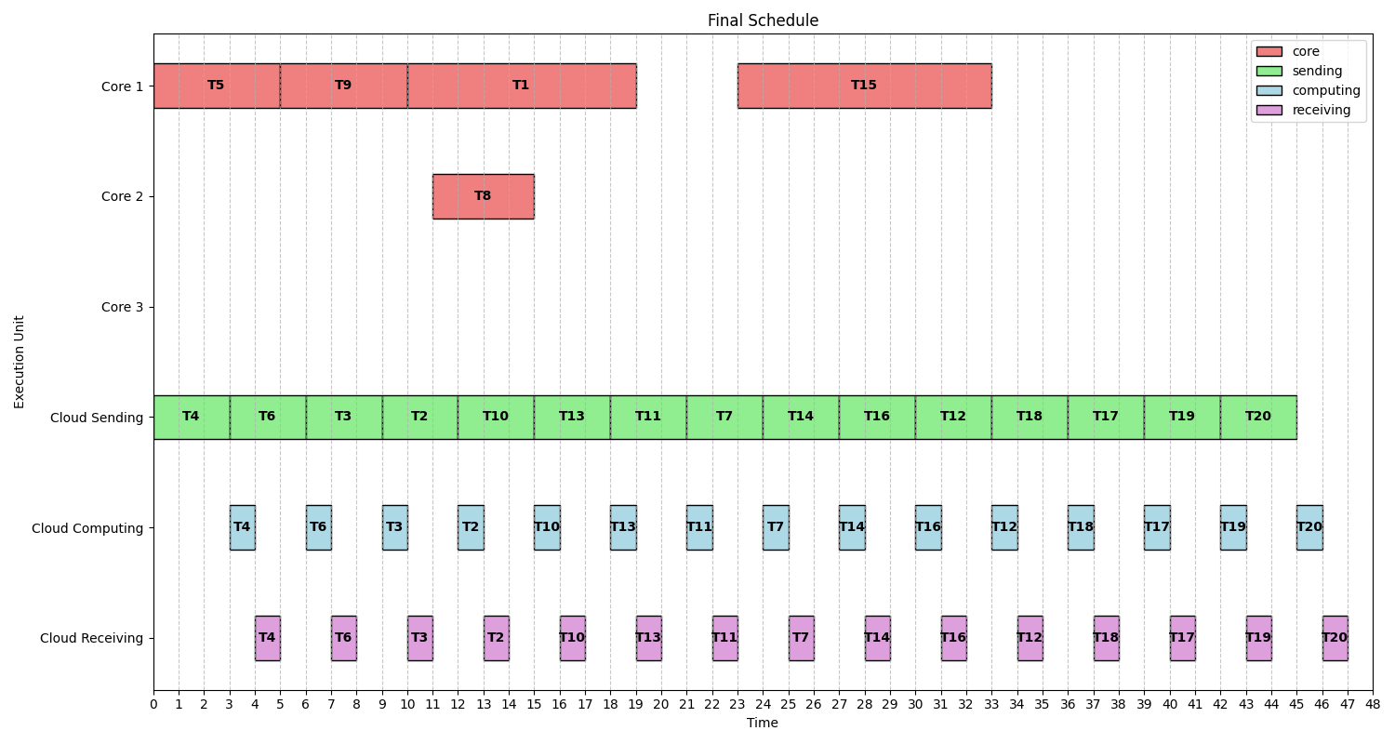
Energy Optimized Task Schedule

Slide 31
Total energy consumption of final scheduling: 59.5
Core1 (P1) = 1, Core2 (P2) = 2, Core3 (P2) = 4, Cloud (Ps) = 0.5
Core 1 Task Count: 4 (T5, T9, T1, T15)
Core 2 Task Count: 1 (T8)
Core 3 Task Count: 0
Cloud Task Count: 15 (T4, T6, T3, T2, T10, T11, T13, T7, T14, T16, T18, T12, T17, T19, T20)
E1 = 1 * 29 = 29
E2 = 2 * 4 = 8
E3 = 4 * 0 = 0
E_cloud = 0.5 * 15 * 3 = 22.5
E_total of final scheduling = E1 + E2 + E3 + E_cloud = 29 + 8 + 0 + 22.5 = 59.5

Slide 32
d) Summary
T_total of initial scheduling : 33
E_total of initial scheduling : 188
T_total of final scheduling : 47 (<49.5 (33*1.5))
E_total of final scheduling : 59.5

Slide 33
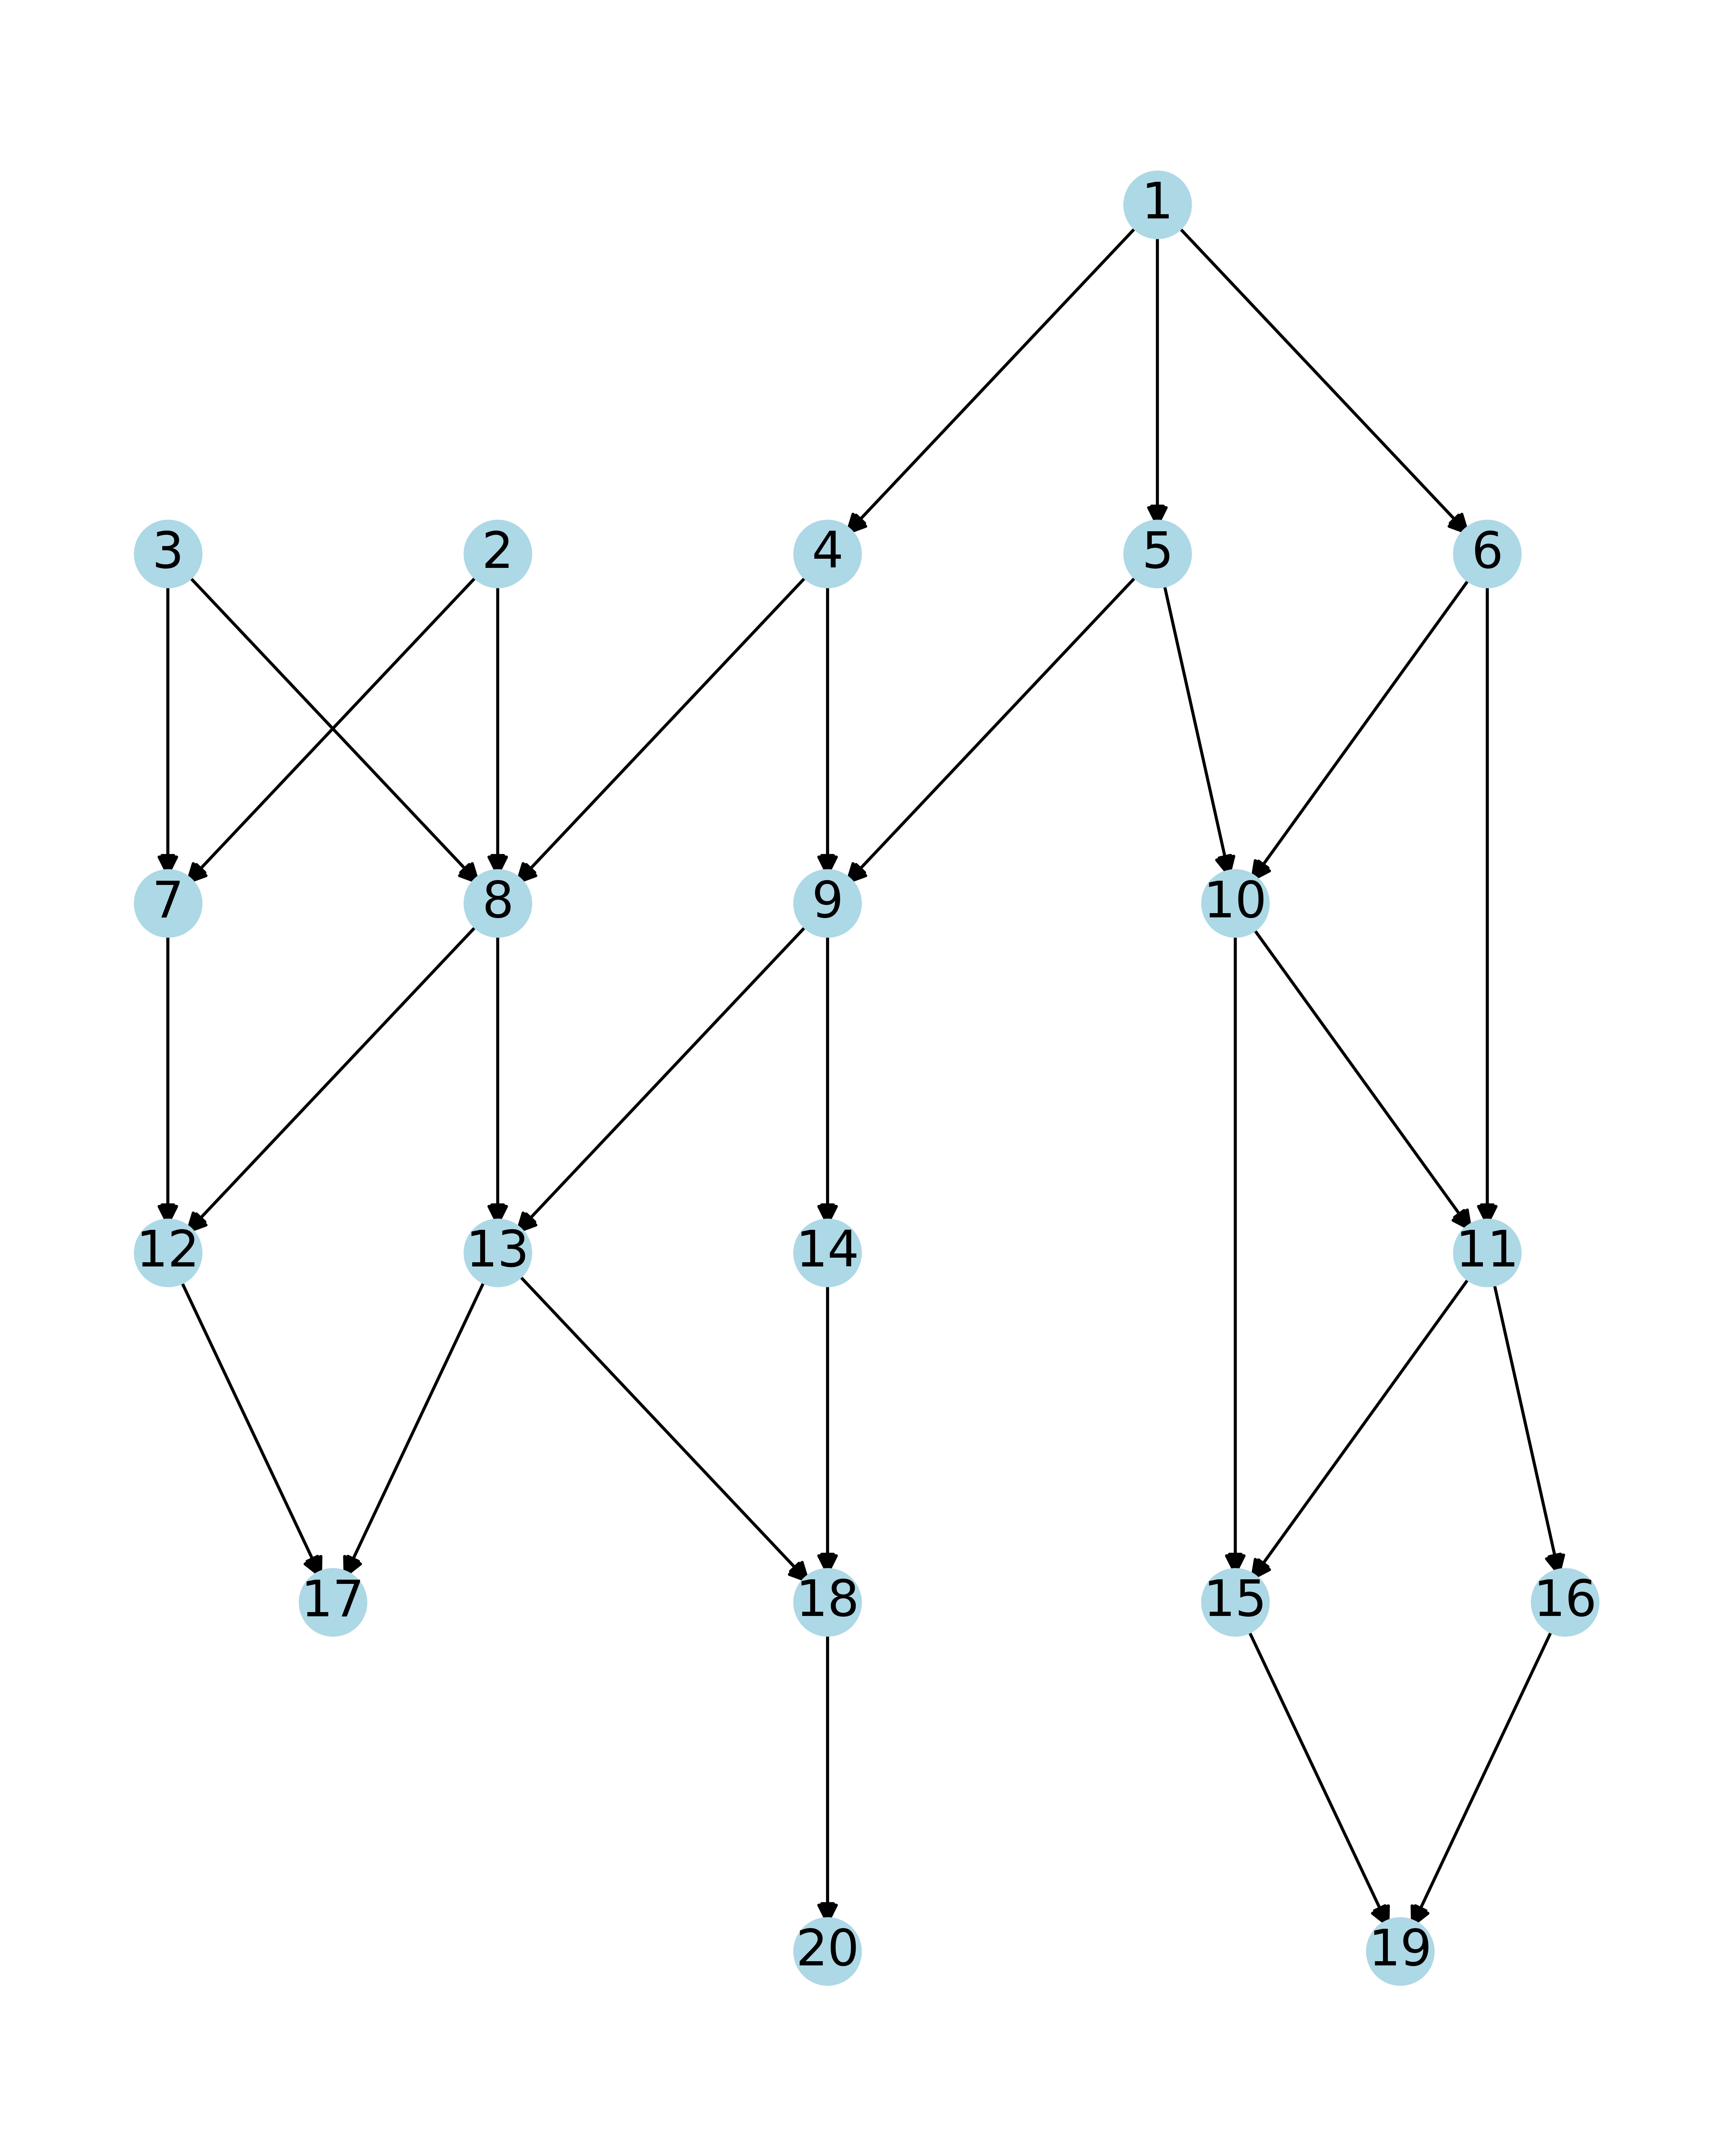
a) Graph 5: Graph3 with multiple entry tasks and multiple exit tasks

Slide 34
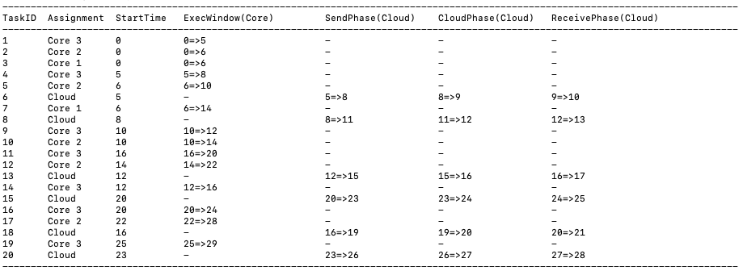
b) Initial Task Schedule Program Output

Slide 35
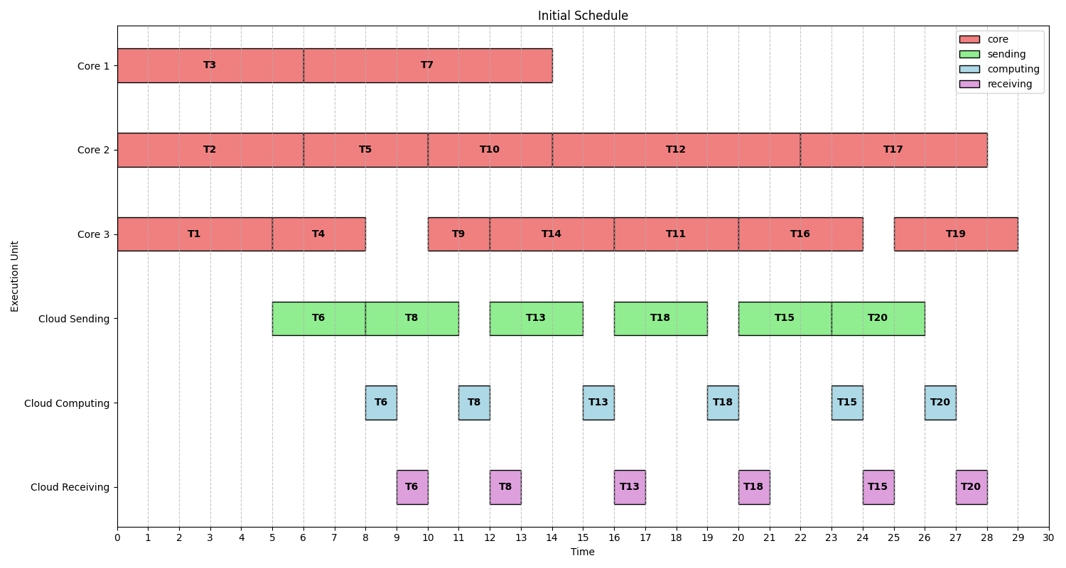
Initial Task Schedule

Slide 36
Total energy consumption of initial scheduling: 183
Core1 (P1) = 1, Core2 (P2) = 2, Core3 (P2) = 4, Cloud (Ps) = 0.5
Core 1 Task Count: 2 (T3, T7)
Core 2 Task Count: 5 (T2, T5, T10, T12, T17)
Core 3 Task Count: 7 (T1, T4, T9, T14, T11, T16, T19)
Cloud Task Count: 6 (T6, T8, T13, T18, T15, T20)
E1 = 1 * 14 = 14
E2 = 2 * 28 = 56
E3 = 4 * 26 = 104
E_cloud = 0.5 * 6 * 3= 9
E_total of initial scheduling = E1 + E2 + E3 + E_cloud = 14 + 56 + 104 + 9 = 183

Slide 37
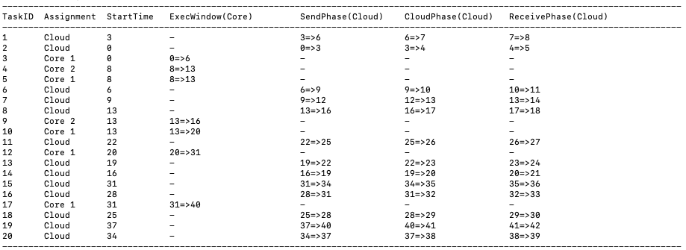
c) Energy Optimized Task Schedule Program Output

Slide 38
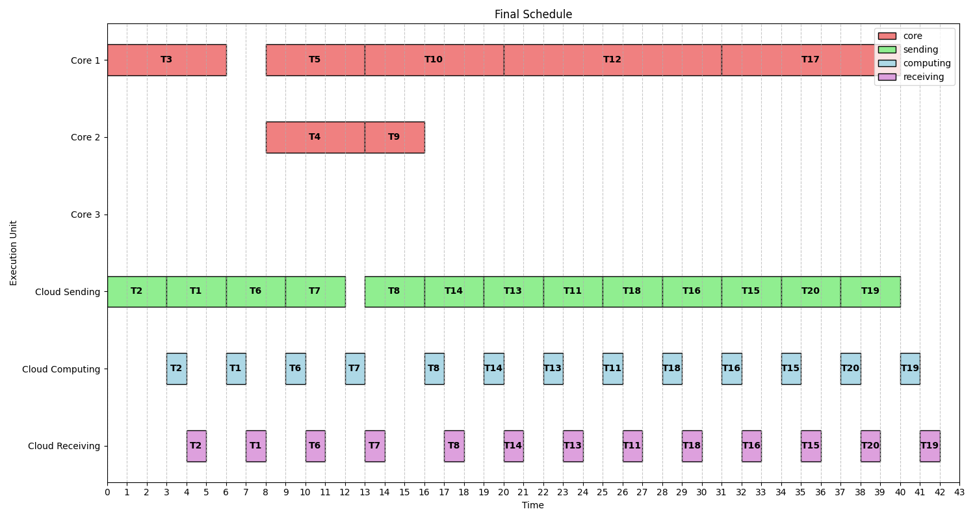
Energy Optimized Task Schedule

Slide 39
Total energy consumption of final scheduling: 73.5
Core1 (P1) = 1, Core2 (P2) = 2, Core3 (P2) = 4, Cloud (Ps) = 0.5
Core 1 Task Count: 5 (T3, T5, T10, T12, T17)
Core 2 Task Count: 2 (T4, T9)
Core 3 Task Count: 0
Cloud Task Count: 13 (T1, T2, T6, T7, T8, T11, T13, T14, T15, T16, T18, T19, T20)
E1 = 1 * 38 = 38
E2 = 2 * 8 = 16
E3 = 4 * 0 = 0
E_cloud = 0.5 * 13 * 3 = 19.5
E_total of final scheduling = E1 + E2 + E3 + E_cloud = 38 + 16 + 0 + 19.5 = 73.5

Slide 40
d) Summary
T_total of initial scheduling : 29
E_total of initial scheduling : 183
T_total of final scheduling : 42 (<43.5 (29*1.5))
E_total of final scheduling : 73.5

